Slide 1
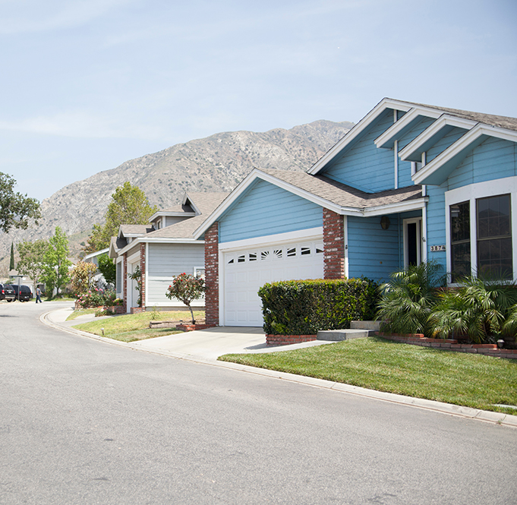
SANTIAGO ESTATES
NEIGHBORHOOD COUNCIL MEETING

Slide 2

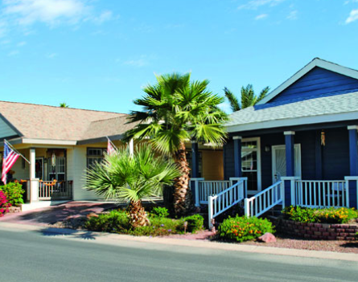
PARTNER IN OUR COMMUNITIES
Equity LifeStyle Properties is the leading operator of Manufactured Home Communities, in North America.
Over the course of over 50 years in business, we have carefully grown our portfolio into a network of premier manufactured home communities in the most desirable locations in the country. Today, Equity LifeStyle Properties, Inc. owns or has controlling interest in more than 400 communities and resorts in 35 states and British Columbia with more than 165,000 sites.

Slide 3





CONSULTANT TEAM

Slide 4
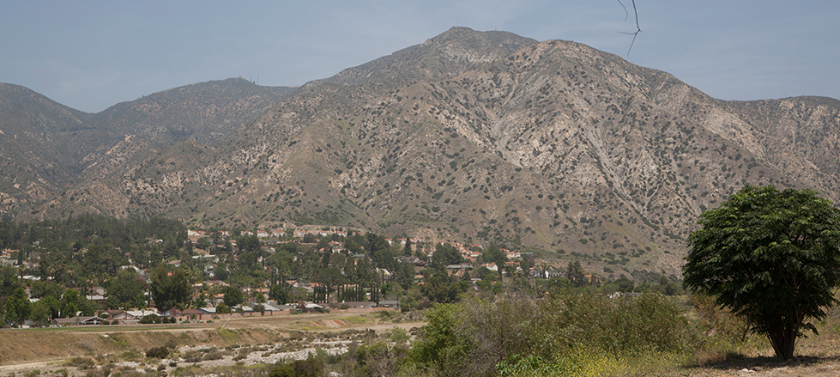
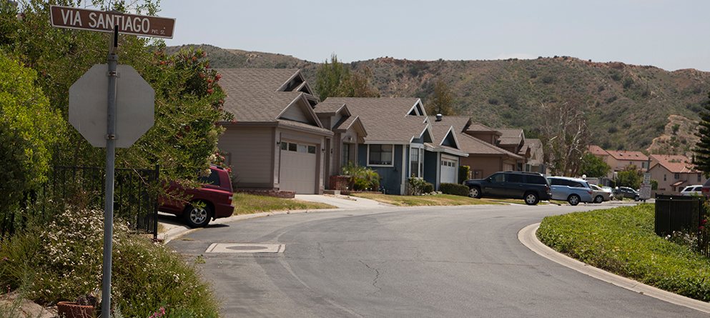
PROJECT SETTING
Nestled at the base of the Los Angeles National Forest, Santiago Estates is a quiet all-age mobile home community.

Slide 5
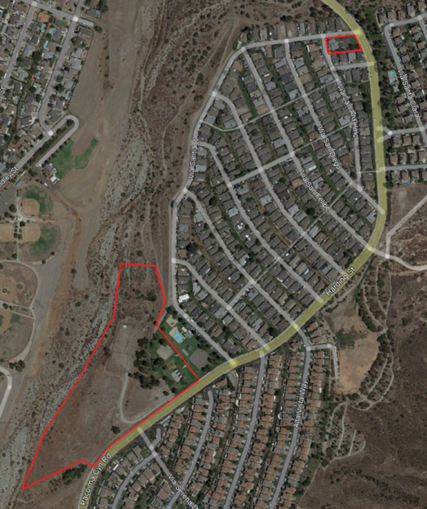
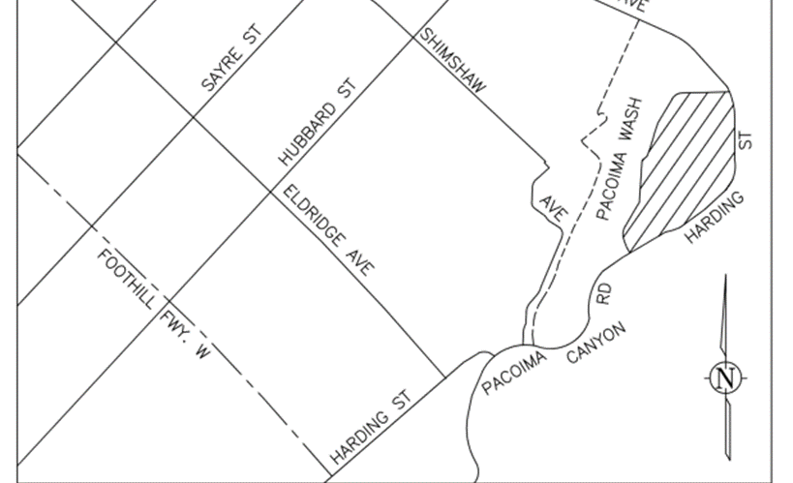
PROJECT LOCATION
HARDING STREET
SYLMAR, CA

Slide 6
PROJECT SUMMARY
47 NEW HOME SITES
ENHANCED AND EXPANDED RECREATION
CLUB HOUSE FOR RESIDENTS

Slide 7
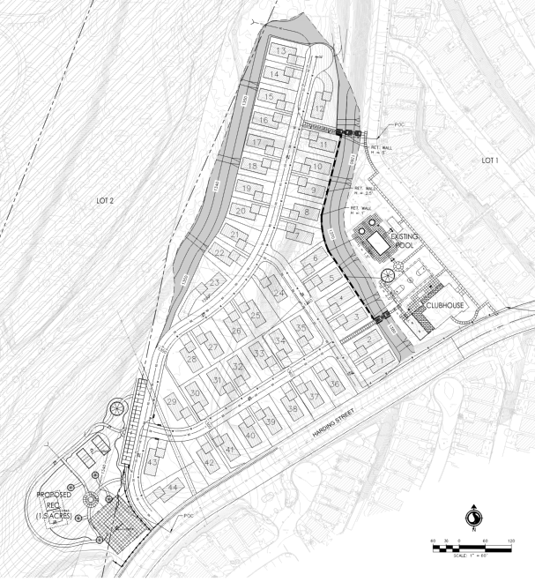
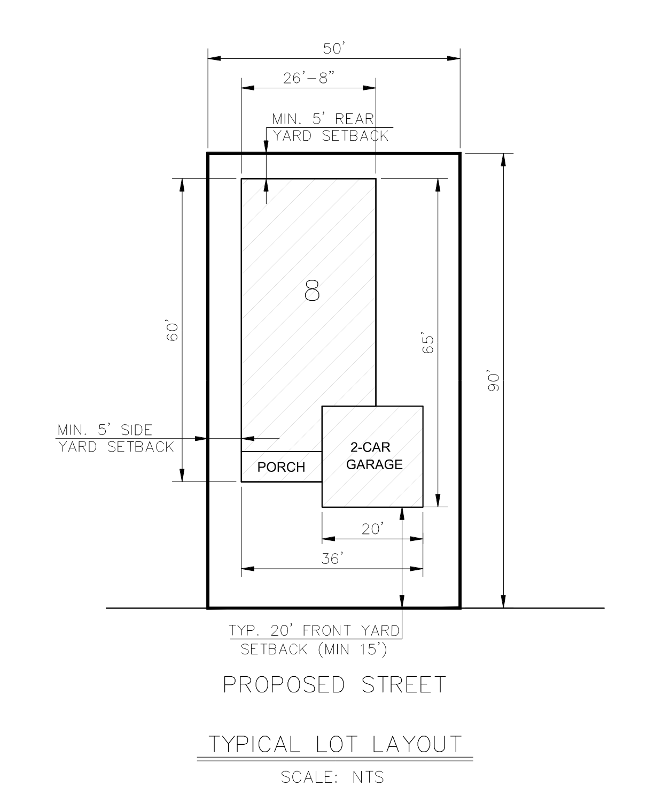
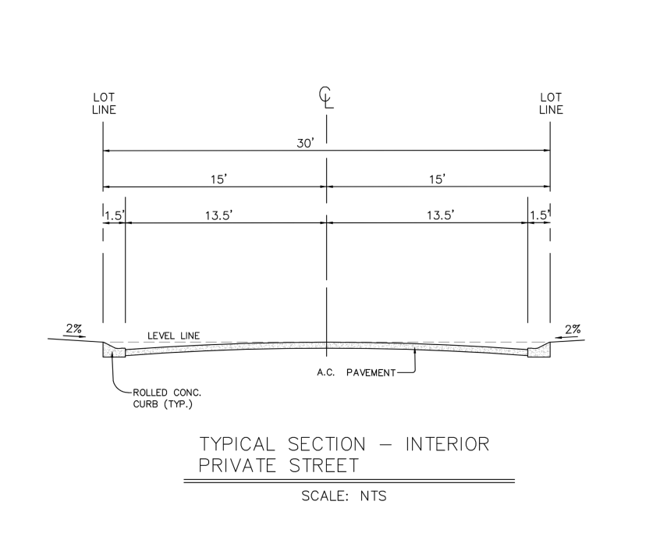
ENGINEERED SITE PLAN

Slide 8
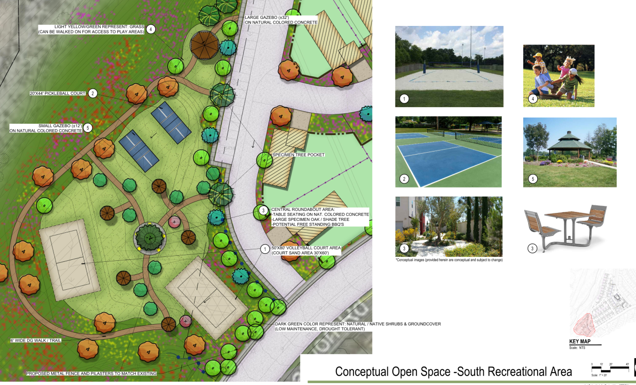
NEW SOUTH RECREATION AREA

Slide 9
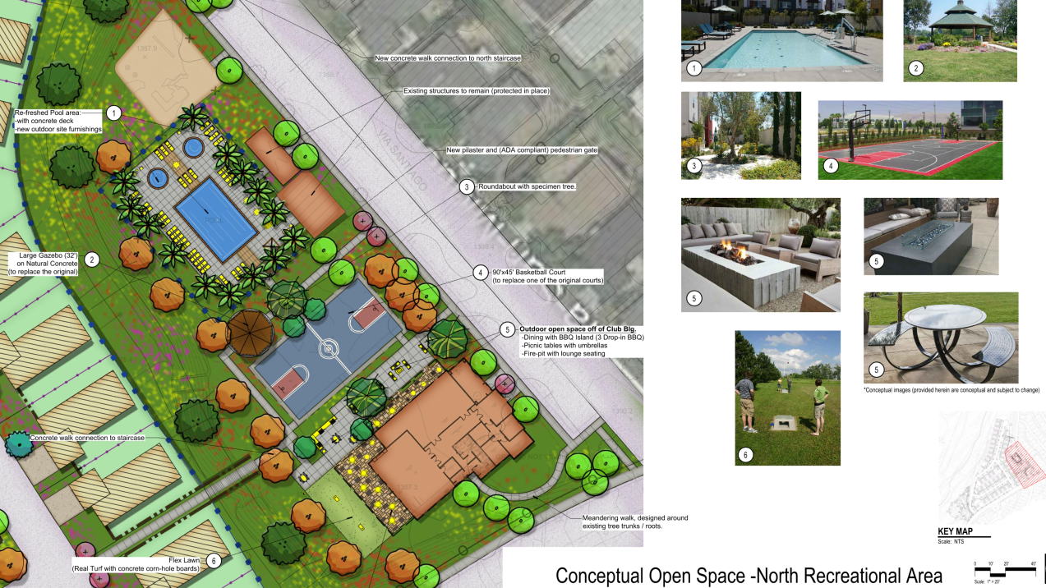
ENHANCED NORTH RECREATION AREA

Slide 10
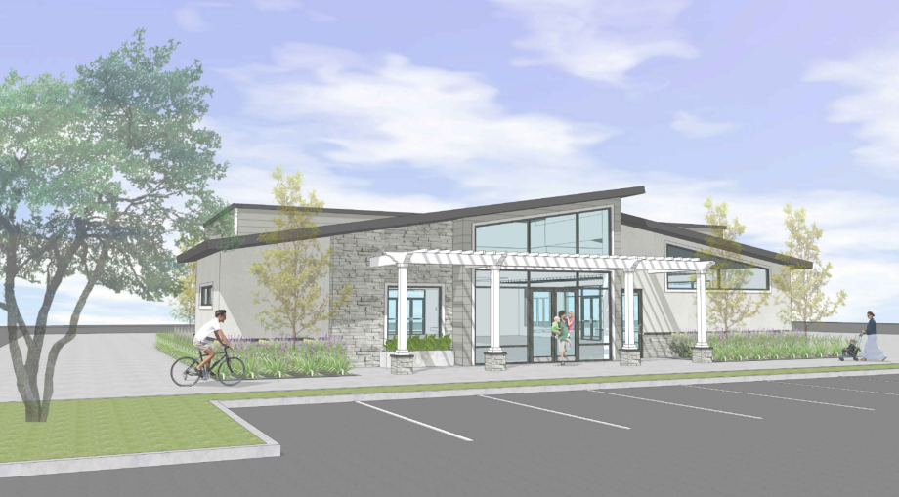
NEW CLUBHOUSE

Slide 11
COMMUNITY FEEDBACK
Q&A

