Slide 1
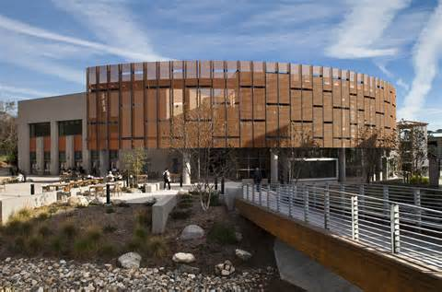
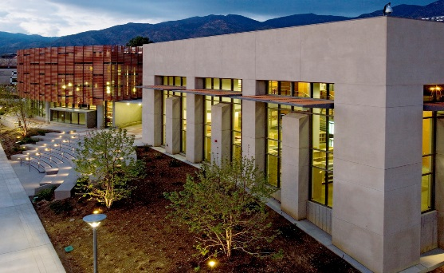
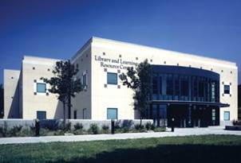
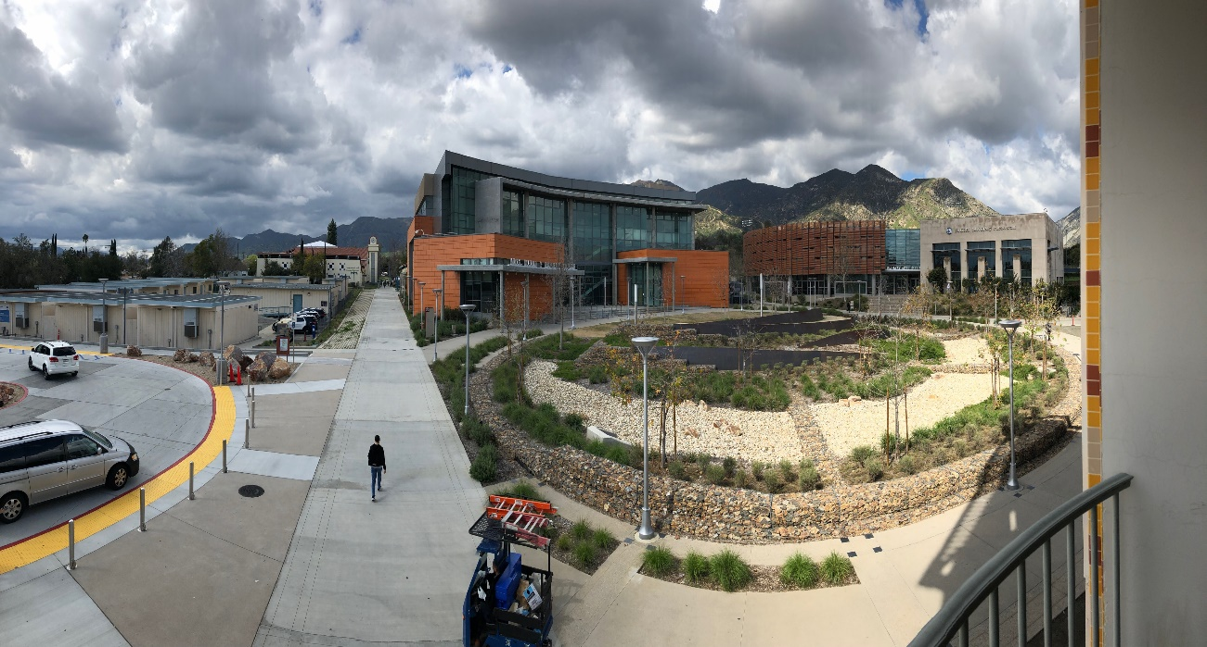
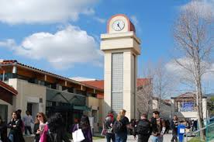
Welcome to LAMC!
Dean Carlos Gonzalez

Slide 2
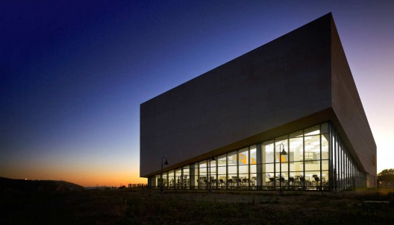
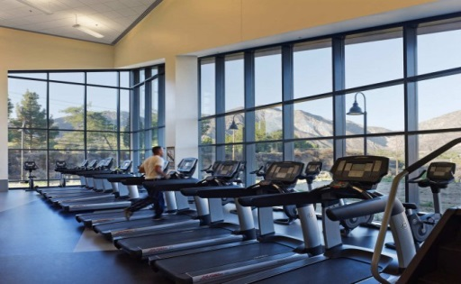
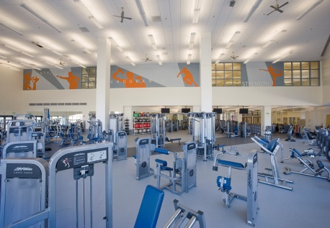
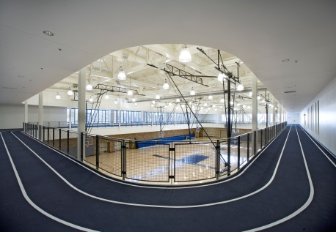
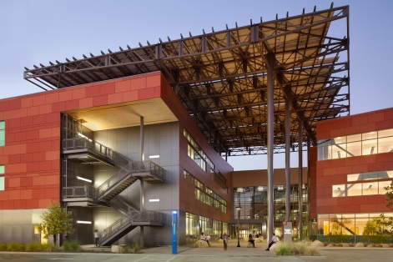
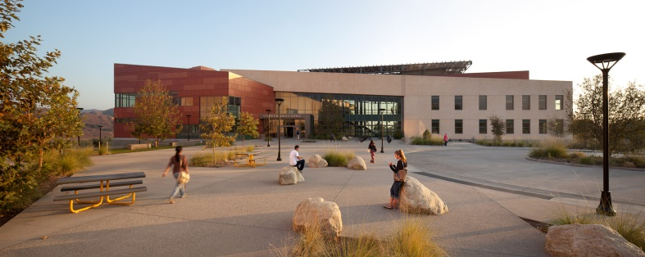
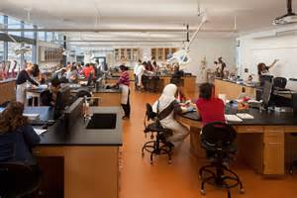
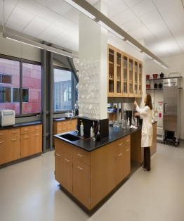
East Campus
Health Fitness Athletic Center (HFAC)
Center for Math & Science (CMS)

Slide 3
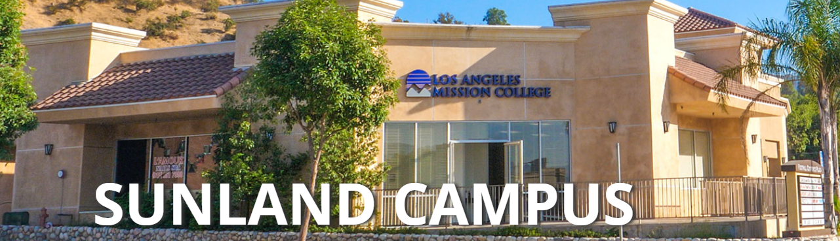
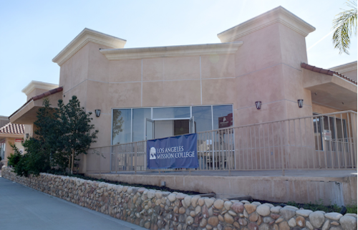
Sunland-Tujunga Campus
7224 Foothill Boulevard (Near Commerce Avenue)
Tujunga, CA 91042
818-875-4036

Slide 4
Why Los Angles Mission College?
Affordable
Small Class Sizes
Additional Support Services
In Your Community
Fresh Start
Opportunities to Explore

Slide 5

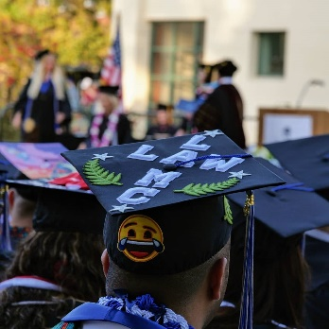
What is your goal?
Earn a skills certificate
Complete an Associates Degree
Complete general requirements to transfer to a 4-year University CSU, UC or a Private University
*LAMC Offers 75 Different majors*

Slide 6
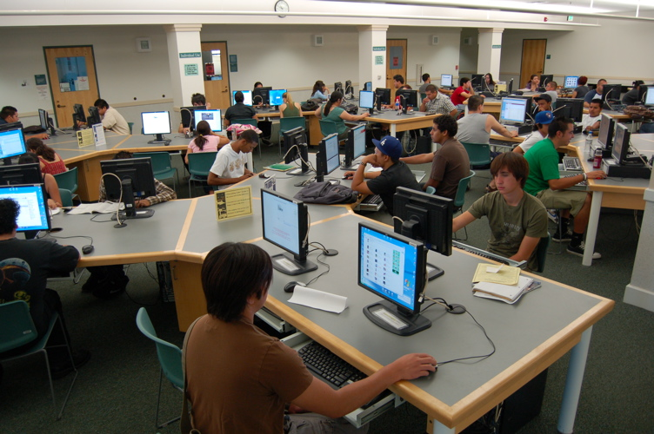
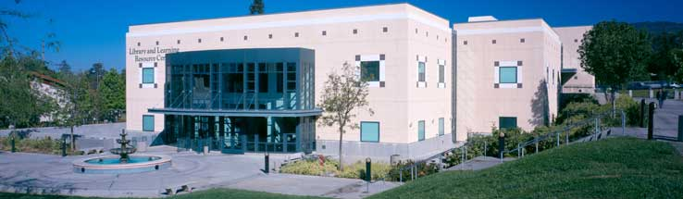
Resources:
Learning Resource Center
FREE Tutoring
  Writing Center
  Science Tutoring Center
  Math Tutoring Center
  Workshops
Library
Printing and computer lab

Slide 7

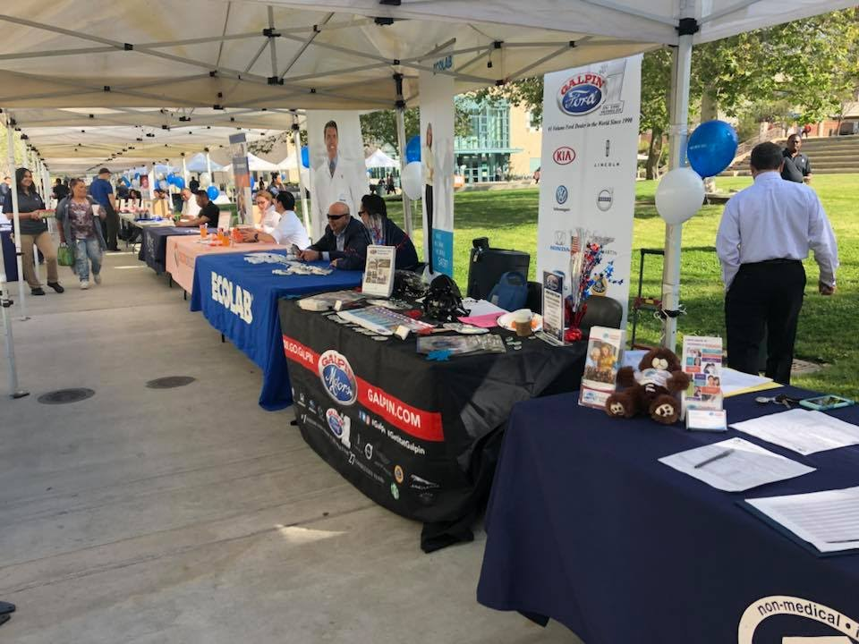
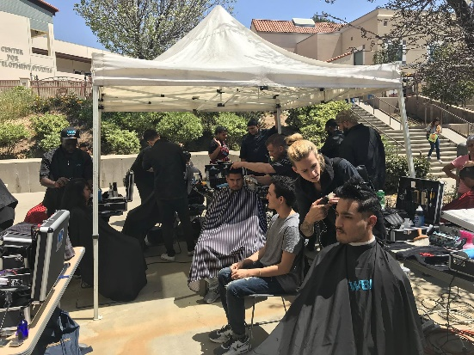
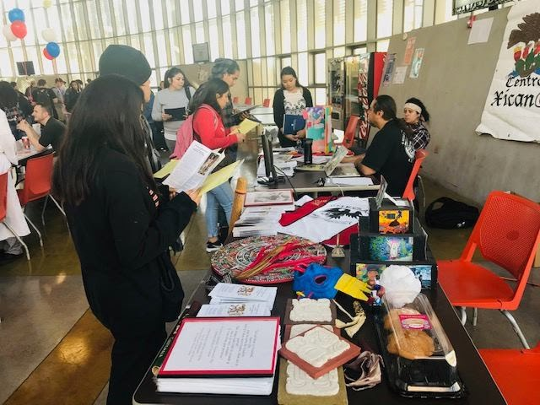
Resources:
Career Center
Career center
Workshops
  Cover Letter & Resume Writing
  Networking & LinkedIn
Career assessment and exploration
Eagles Job board
Events
  Major Fair
  Job and Career Fair
  Internship Fair

Slide 8
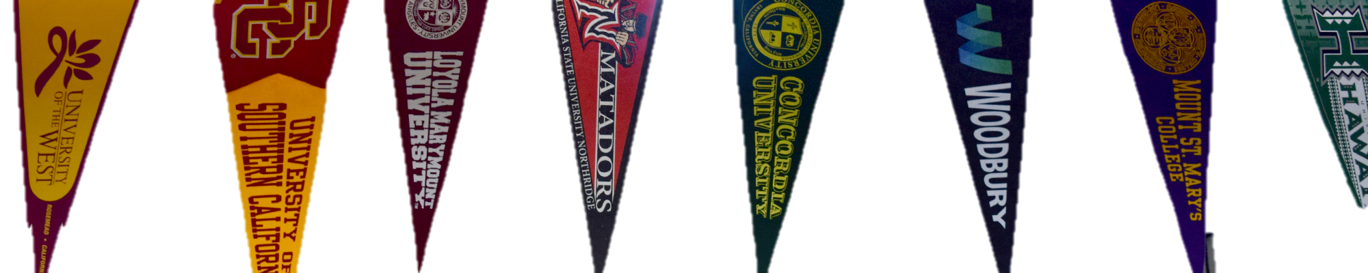

Resources:
Transfer Center
Transfer counseling
Appointments with four-year college and university representatives
Peer mentoring (Play Video)
Assistance with college and university applications
Computer access for online research
Transfer workshops

Slide 9

Additional Support Programs
DSPS
International
Veterans
CalWORKs
Next Up
Foster and Kinship

Slide 10
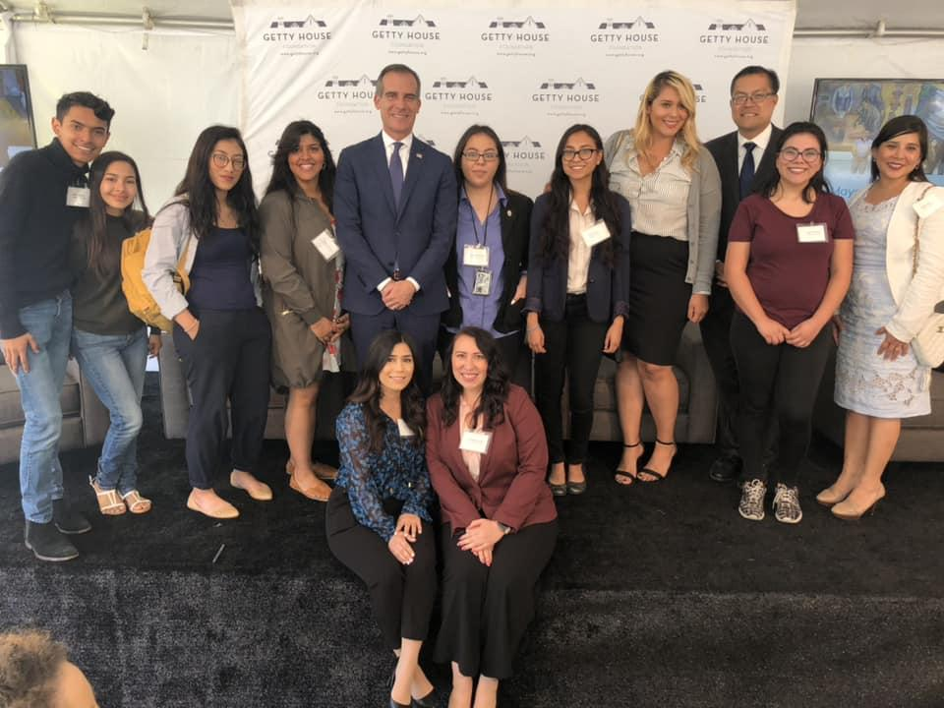




Specialty Programs
Extended Opportunity Program & Services (EOPS)
METAS
TRIO
True Promise

Slide 11

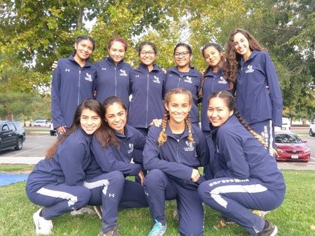
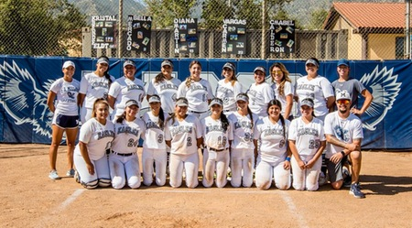
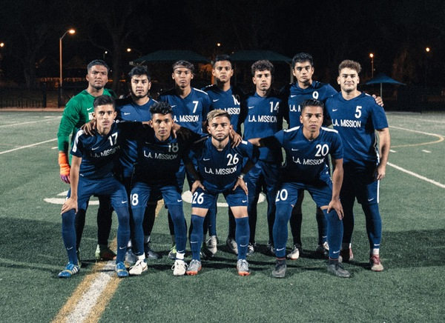
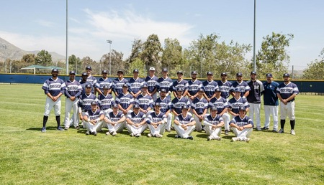
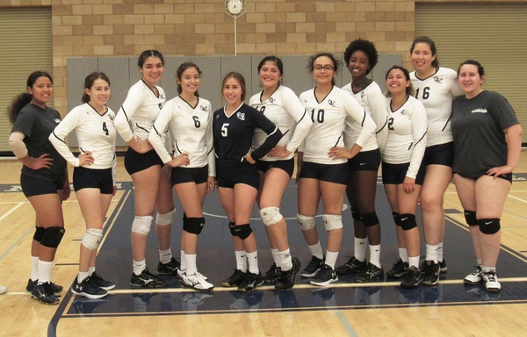
Athletics
Men’s Soccer
Men’s Baseball
Women’s Softball
Women’s Volleyball
Women’s Cross Country

Slide 12
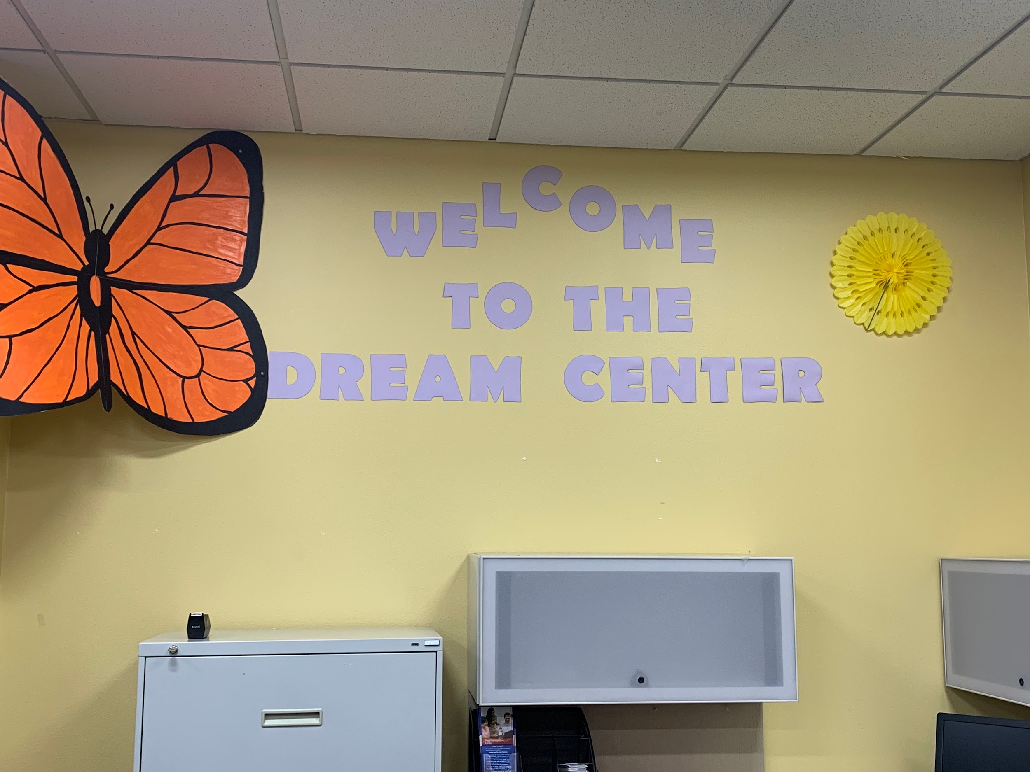
Dream Center
Connect with resources:
DACA
AB540
Dream Act Application
Safe place
Basic Needs Center

Slide 13
How to pay for College
Financial Aid
LA College Promise Benefits
LA Promise
1-2 years of free full-time enrollment (not including Winter session)
Free Summer Transition to prepare for college
California
Promise
California Promise
Grant

Slide 14
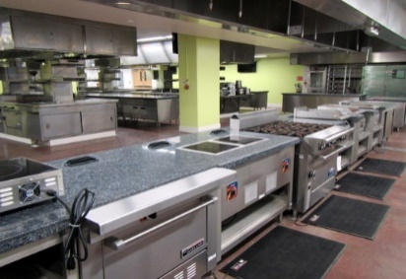
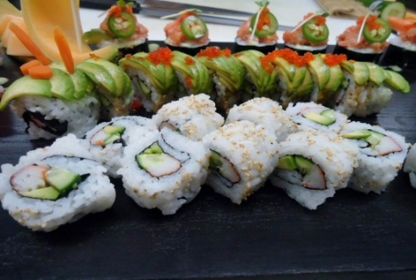
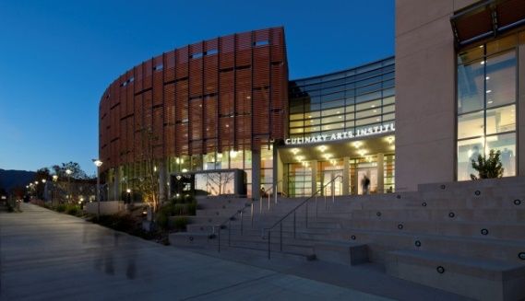
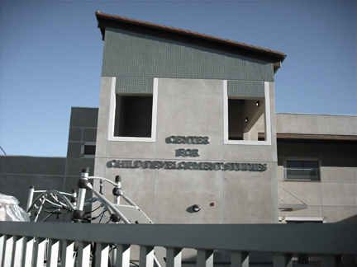

Career
Education
Culinary Arts
Culinary
Professional Baking
Child Development
Restaurant Management
Probation/Correction Officer Candidate
Administration of Justice
Basic Police Academy Prep
CTE
Crime Scene Technology
CNA
Pharm Tech
Allied Health
Health Occupations
Biotech
Medical Billing & Coding
LAMC offers more Career Certificates

Slide 15

"Education is the most powerful weapon which you can use to change the world.”
—Nelson Mandela
Orientation to STEM Majors
Los Angeles Mission College
Par Mohammadian, RPh, PhD

Slide 16

Overview of all STEM majors at LAMC
AS in Computer Sciences & Certificates
AS in Engineering & Certificates
AS-T in Mathematics
AS-T in Biology
AS in Biology
AS in Biotechnology & Certificates
AS-T in Physics UCTP
AS-T in Chemistry UCTP

Slide 17
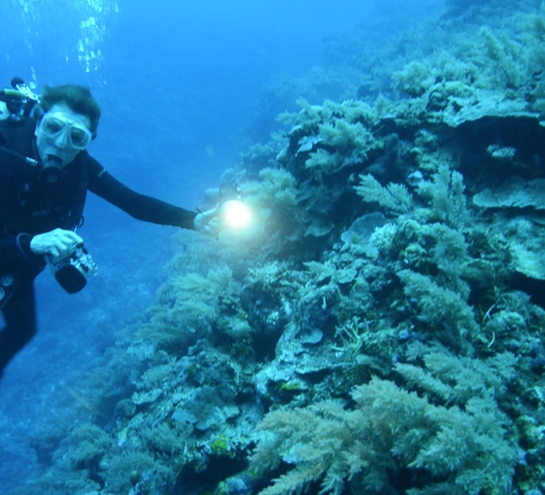
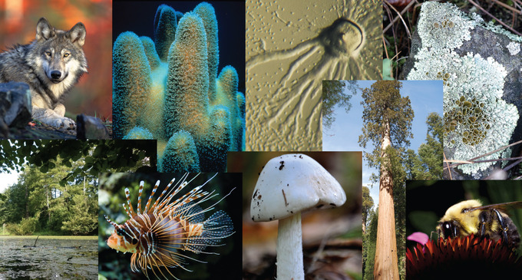
AS & AS-T in Biology
Some common career paths
for biology majors:
Research Scientist, Pharmacologist
Ecologist, Forensic Scientist, Teacher, Government Agency Roles, Wildlife Biologist, Veterinarian, Dentist, Physician, Optometrist

Slide 18

BS in Biomanufacturing at LAMC
AS in Biotechnology
  Some common career paths
  for biotech majors:
    Manufacturing Assistant / Technician
    Microbiology Quality Control (QC) Technician
    Molecular Biology Technician
    QC Analyst, QC Technician
    Water Quality Technician

Slide 19





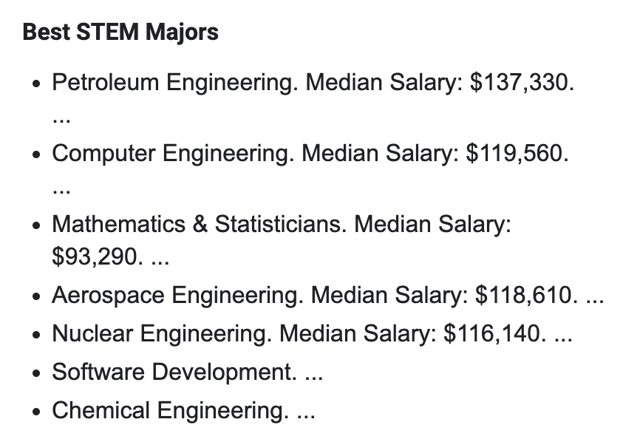
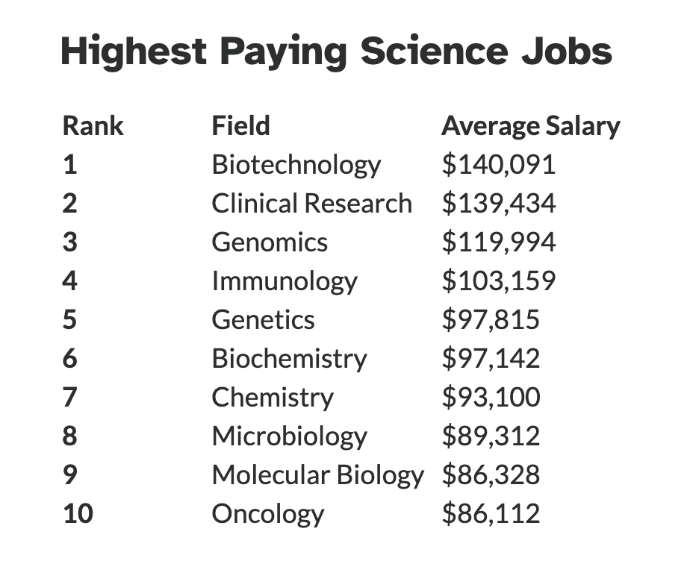

Why STEM degrees?
Jobs are waiting for our STEM graduates!
Across the U.S. there is a shortage in supply of qualified STEM workers and teachers.

Slide 20
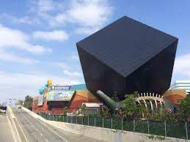
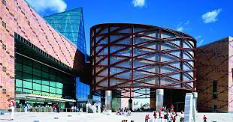
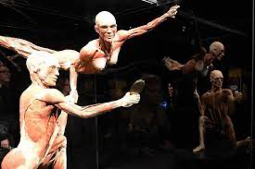
How to get our kids/students
interested in STEM?
Interest
Discovery Cube in Sylmar
CA Science Center in LA
Body Worlds Exhibition
Academic Prep: Math & Science courses in High School
LAMC can help with Math Prep

Slide 21
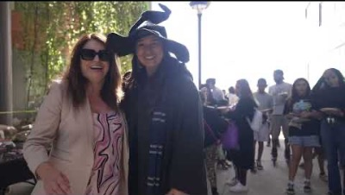
LAMC STEM events – motivate our kids/students/community to create interest in STEM
Last Saturday in October
Magic of Sciences Magia de Ciencias
https://www.youtube.com/watch?v=T68rWpPDiT0

Slide 22
Annual Mini-Symposium – From Education to Employment - In March
(March 17, 2023, from 10 am – 12 pm)
LAMC STEM events – motivate our students/community to create interest in STEM & learn about employment opportunities

Slide 23

Support Services:
Title III STEM grant
National Science Foundation HSI & ATE
Tutoring
Paid summer internships
Faculty Mentorship
Winter & Summer Math Academies
Employment Opportunities
Honors Program
Interested in transferring to UCs?

Slide 24
Interested in learning more about our programs & dual enrollment & a tour of our labs?
Do you want us to present and/or demonstrations in your classes?
Contact us!

Slide 25

Resources for Families
Fabiola Mora
Jan 27, 2023

Slide 26

English Language literacy
English as a Second Language (ESL)
Courses focus on conversation, reading and beginning grammar aimed at preparing students for higher level academic English courses.

Slide 27
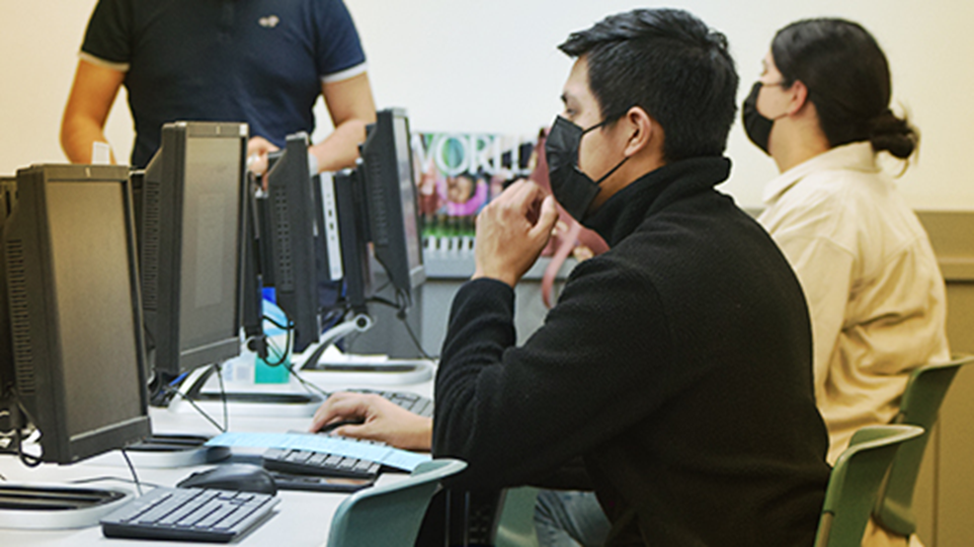
LEARN BASIC Computer Skills
Basic skills in computer course is designed to teach students:
basic computer hardware,
Some knowledge of computer operating systems including monitor, mouse, keyboard
Simple skills on how to use Microsoft office
Use of online search engines
Tools on how to send and receive simple email messages

Slide 28

PREPARE FOR CITIZENSHIP
Our Citizenship courses introduce students to:
US history and American government topics including the three branches of government, American symbols such as the flag and other concepts needed to prepare for US citizenship exam

Slide 29

PREPARE FOR GED
Our GED courses prepare students to successfully pass the GED exam
We offer a sequence of 4 courses in the areas of:
  Literature and the Arts
  Social Studies
  Math
  Science

Slide 30



